Slide 1
DETERMINATION OF GENUINENESS OF A MEDICAL PROFESSIONAL
Prepared by:
Aayush Shah (SAP: 60004140091)
Pranay Shah (SAP: 60004140101)
Dipam Vasani (SAP: 60004140116)

Slide 2
MOTIVATION
To protect a patient’s privacy in a hospital management system. Example
Prevent mediclaim information from being leaked to insurance agencies.
Prevent patient’s sensitive information such as mental illness, abortion or HIV status from being leaked without consent.
Spotting out unqualified practitioners or ‘quacks’ who may further complicate an illness instead of curing it.
Prevent doctors from performing unnecessary surgeries.
Existing solutions inadequate and inaccurate.

Slide 3
LITERATURE REVIEW
REFERENCE PAPER | MODEL | DRAWBACKS
Quantified Risk-Adaptive Access Control for Patient Privacy Protection in Health Information Systems | A risk based adaptive model to keep a check on the data consumed by information consumers. | The system is less accurate and considers only one parameter i.e. relevance of data accessed.
Clustering-based Analysis in Hospital Information Systems | A clustering based algorithm to group orders based on various identified attributes | Clustering may lead to a lot of fake orders forming a cluster.

Slide 4
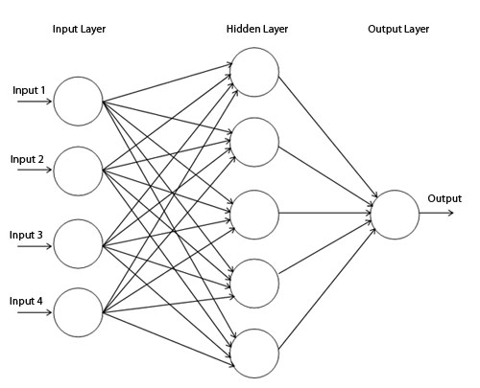
OUR SOLUTION
Use a Supervised Neural network.
Takes 5 parameters as input.
1 output between 0 and 1.
Output compared with threshold to determine whether a doctor is ‘genuine’ or ‘malicious’.
Trained via error backpropogation.
Intricate Knowledge base defined for training phase

Slide 5
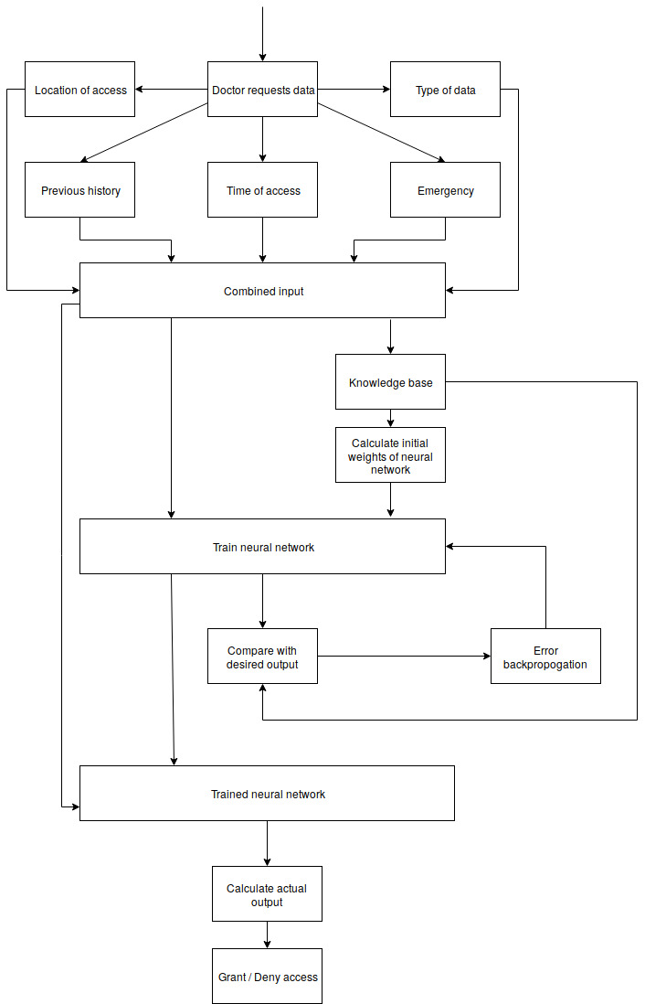
FLOWCHART
Doctor requests data.
Parameters captured and combined to form input to a neural network.
For training phase a Knowledge base determines desired output and initial neural weights.
Trained using error back propogation technique.
After training phase - actual output of the data is calculated.
Output compared with predefined threshold. If output greater than threshold then doctor is malicious.
Access denied to malicious doctors.

Slide 6
ADVANTAGES OF OUR MODEL
Provisions for emergency/special cases are taken in the model.
Previous access history of a doctor taken into account.
High accuracy as a large number of examples will be used for training via error backpropogation technique.
Time efficient once training phase is completed.

Slide 7
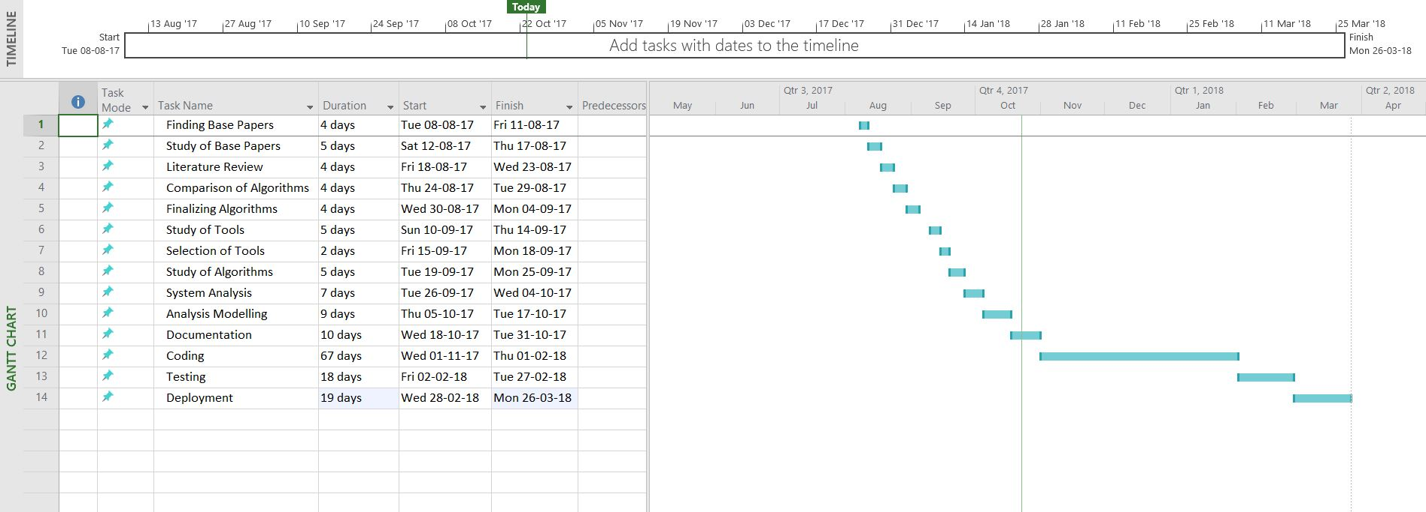
SCHEDULE FOLLOWED

Slide 8
CONCLUSION
We have successfully designed a system that checks the genuineness of a medical professional.
Data access is denied to a malicious doctor, thereby protecting critical patient data.
Knowledge base to find relevance of data accessed designed for 5 specializations.
Creation of a data set and implementation of the project to be done next semester.
Future scope could be to expand the base for additional specializations.

Slide 9
Thank you!

